Slide 1



POSEIDON AI
Surf the internet with trust and safety in mind

Slide 2



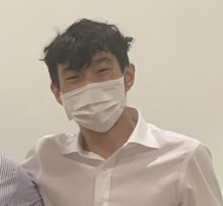
The Team
KARTHIK
WEI JUN
JUN MING
PIN SHIEN

Slide 3



As a parent we are concerned about what our kids view on social media

Slide 4

Now lets visualise them scrolling Instagram

Slide 5


BUT THIS COMES UP !!!

Slide 6







EXECUTIVE SUMMARY
Empowering Singaporeans to actively combat misinformation
How can we empower every Singaporean to actively combat misinformation in the next 5 years?
QUESTION
Misinformation and hate speech spread fast, making containment tough.
Algorithms amplify biases, reinforcing false narratives.
Balancing regulation and rights is a challenge.
CHALLENGES
STEP #1
STEP #2
STEP #3
Identify and flag manipulated and misinformative content.
Contain hateful content in any form before it spreads.
Dashboard for governments to identify hate and misinformation themes, allowing for data driven decisions
SOLUTION
For Users,
For Social Media Platforms,
For Governments,
Empowers individuals to verify information and navigate digital spaces responsibly.
Encourages stronger content moderation and fact-checking to curb misinformation.
Promotes policies that balance regulation, free speech, and online safety.
IMPACT
6

Slide 7
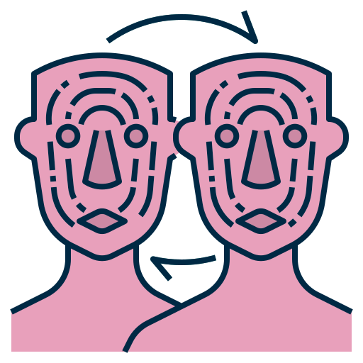


PROBLEM
The spread of misinformation and hateful content online threatens societal trust and harmony, requiring urgent solutions to mitigate its impact.
²/₃ of Singaporeans encountered harmful/misinformative content online
ISSUE #1
ISSUE #2
ISSUE #3
The rise of deepfakes undermines trust in digital media
Hateful memes fuel division and spread harmful narratives.
Misinformation text classifiers struggle to accurately detect false content.
Blurs the line between reality and deception, harder to distinguish truth from manipulation.
Normalize extremist behaviours and ideologies, potentially leading to physical violence
Unverified information creates a ripple effect of anxiety, creating confusion and distress.
Sources: https://www.mddi.gov.sg/media-centre/press-releases/survey-by-mci-on-harmful-online-content-encountered-by-sg-users/
7

Slide 8
Harmful Meme Classifier
Identifying, explaining and filtering why harmful memes from social media platforms

Slide 9
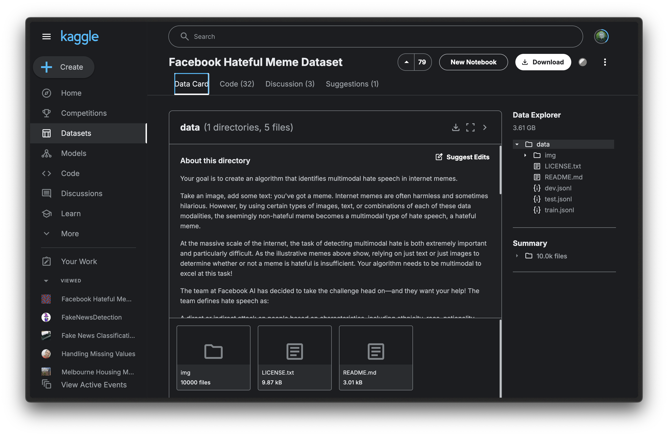

Primary Dataset
FACEBOOK HATEFUL MEME DATASET
Data Quality: Relatively Clean
Columns: ID, Image, Text, Label
Rows: ~10K Rows
Source: Kaggle Datasets

Slide 10
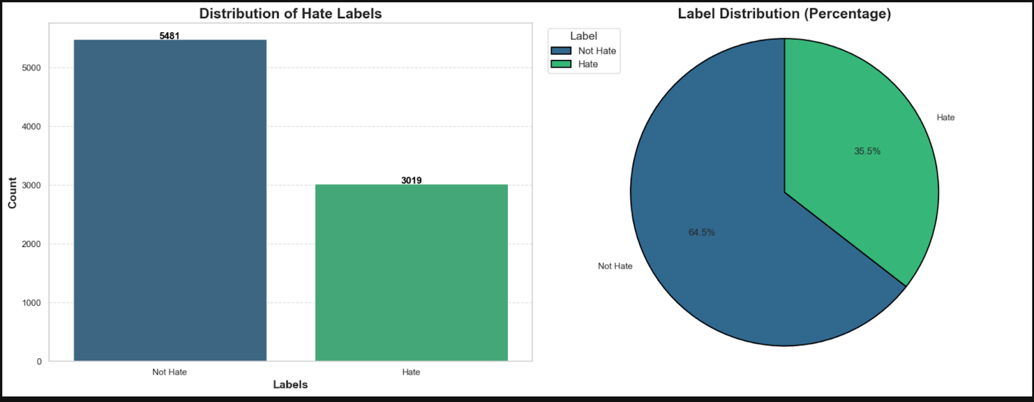
Secondary dataset - Web Scraping
Data Imbalance
(biased towards no hate)

Slide 11
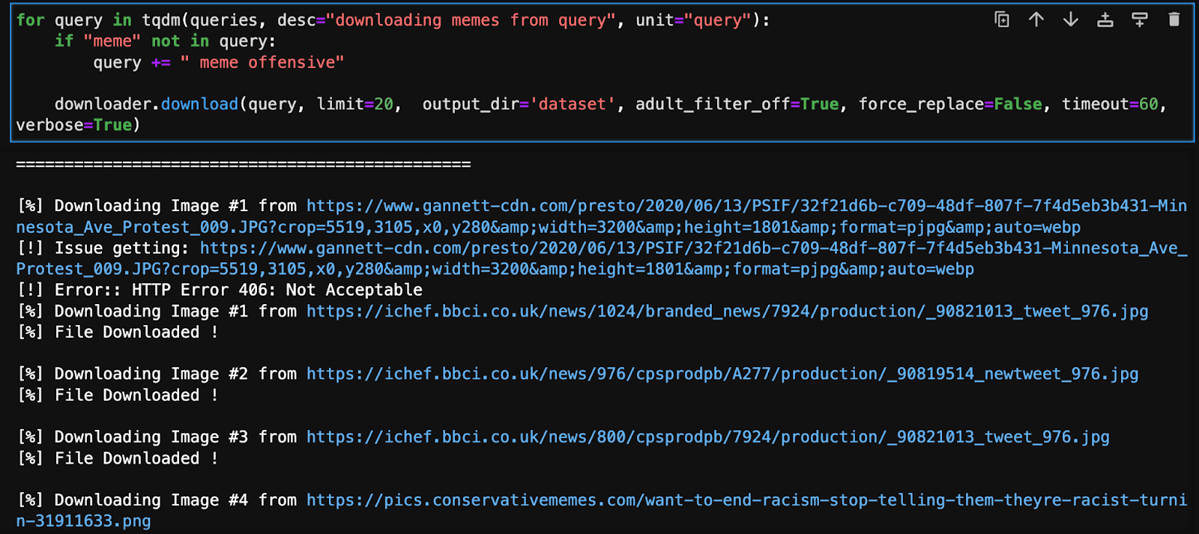

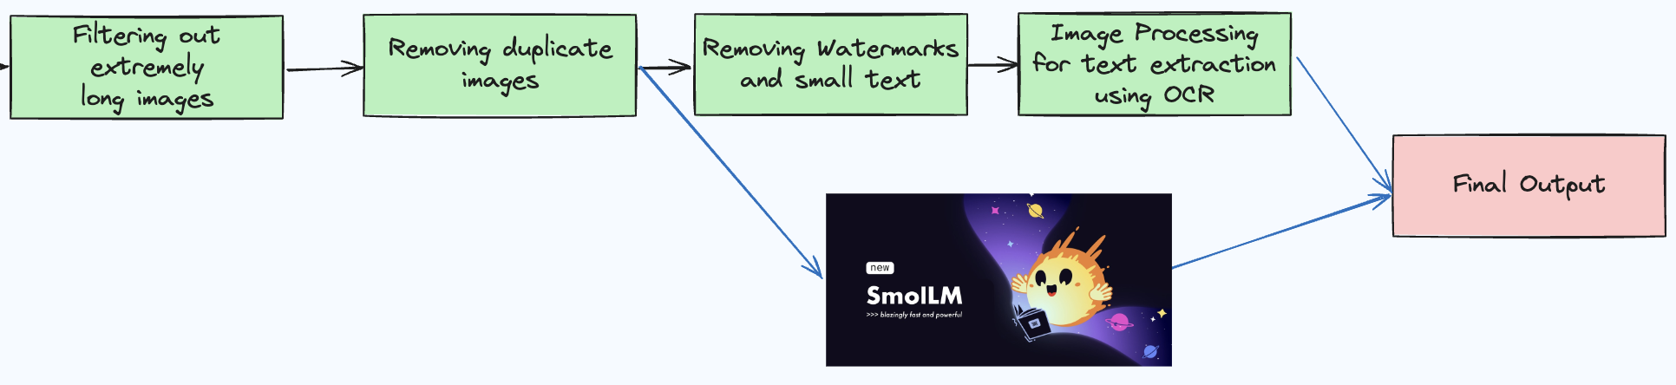
Secondary dataset - Web Scraping
2600 images
100+ offensive topics

Slide 12

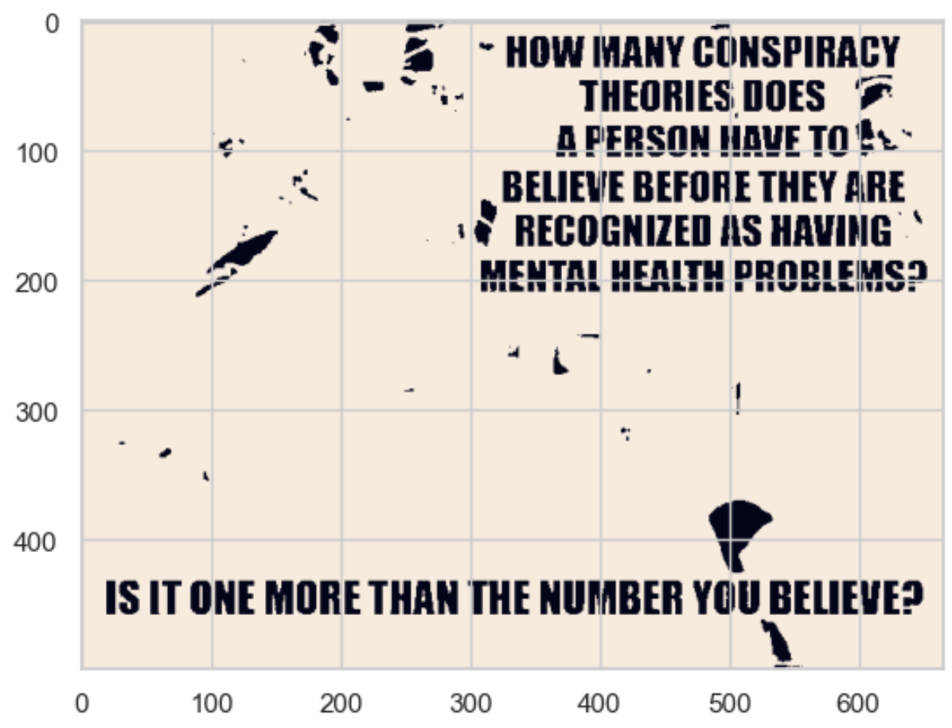
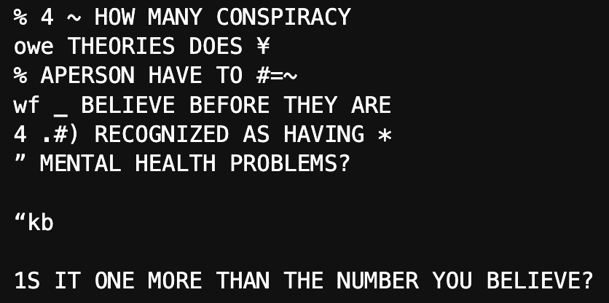



Web Scraping – OCR from memes

Slide 13
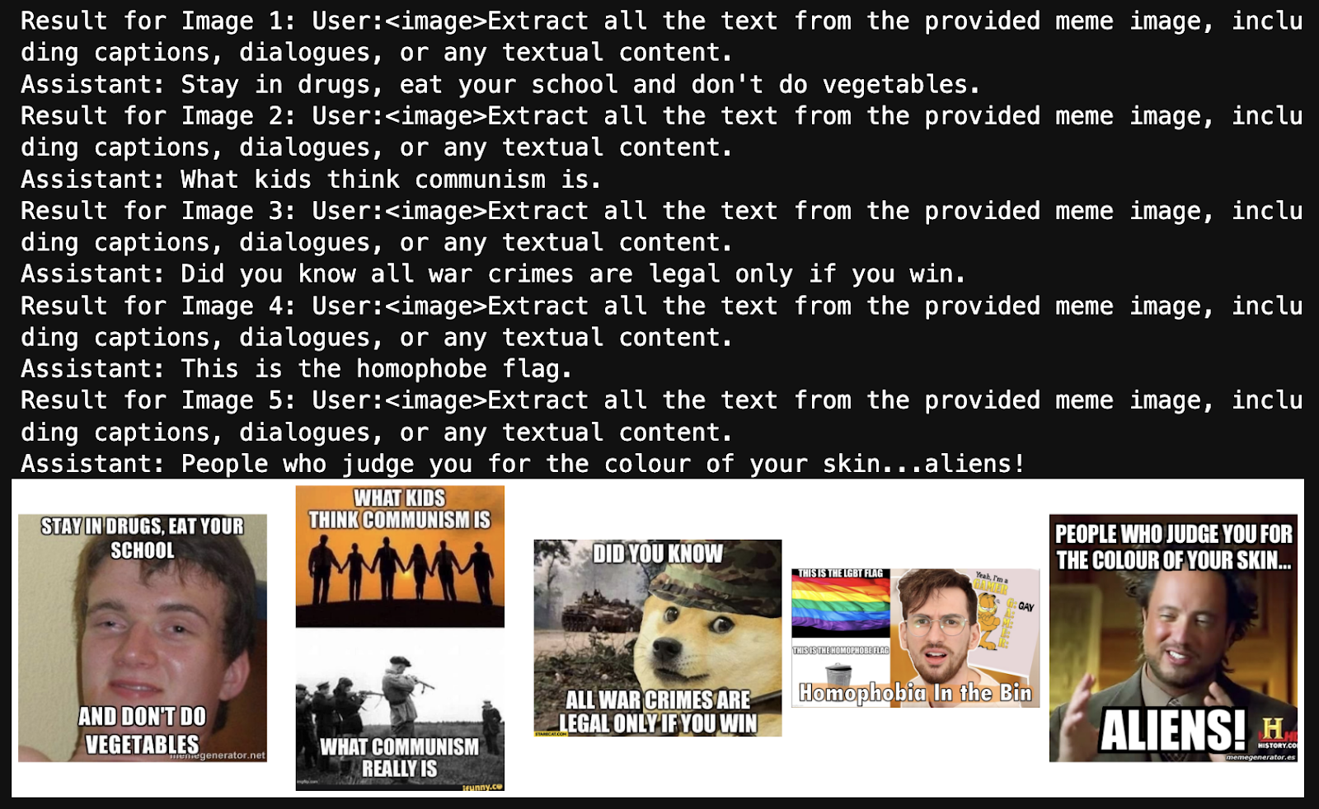
Web Scraping – OCR from memes

Slide 14
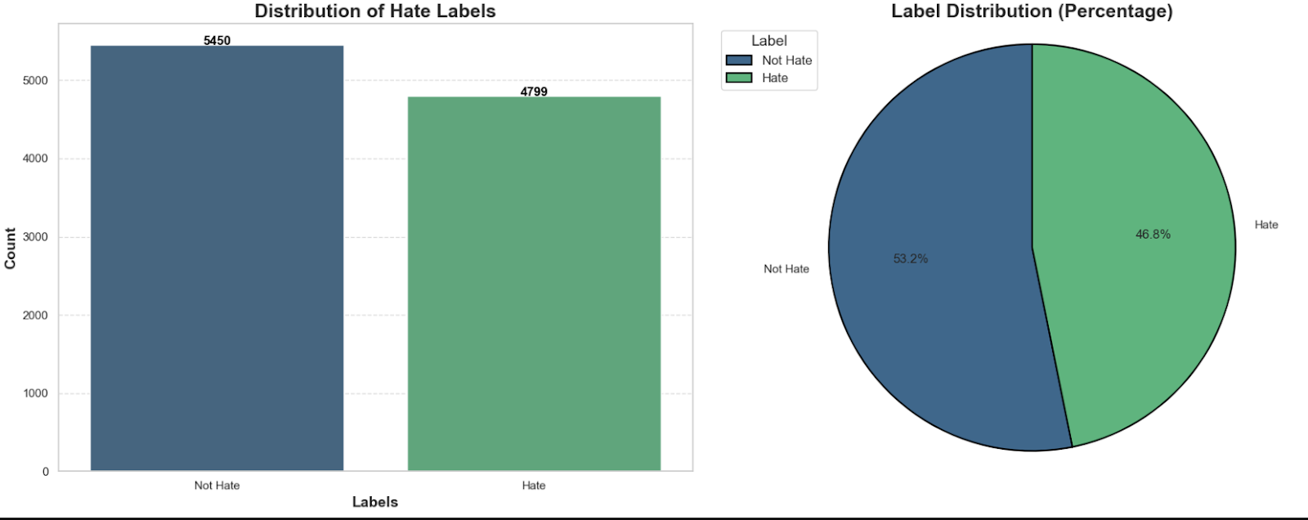
Web Scraping
Data is balanced

Slide 15
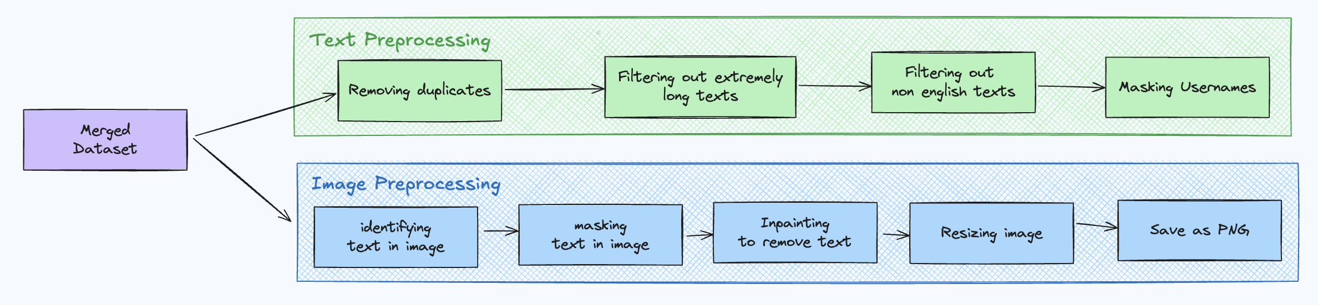
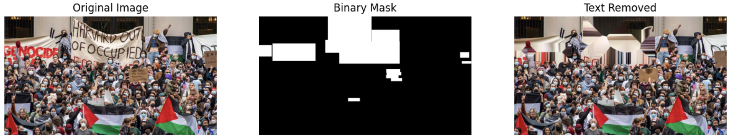
Data Preprocessing

Slide 16
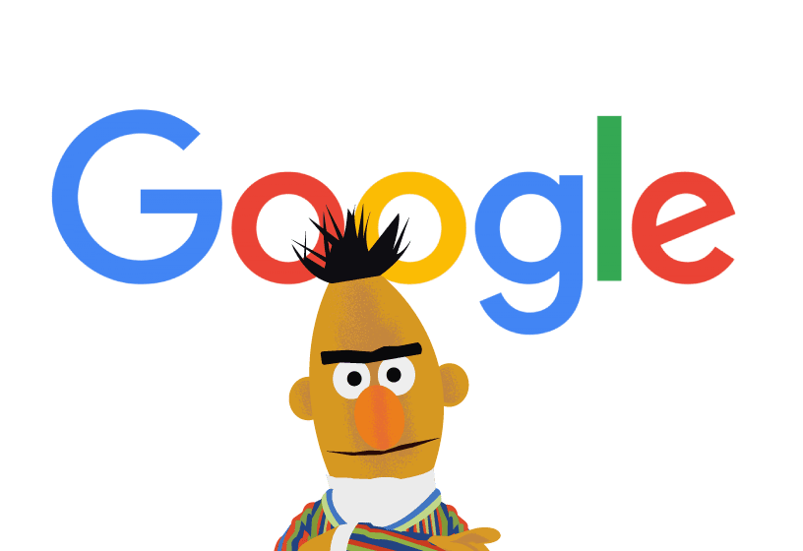

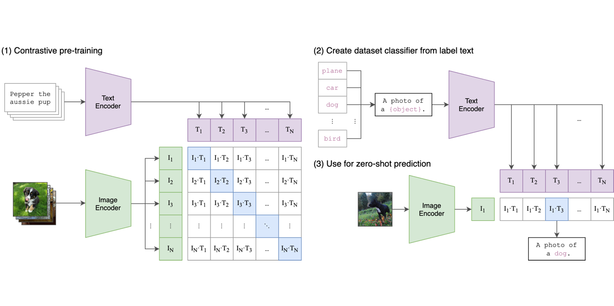
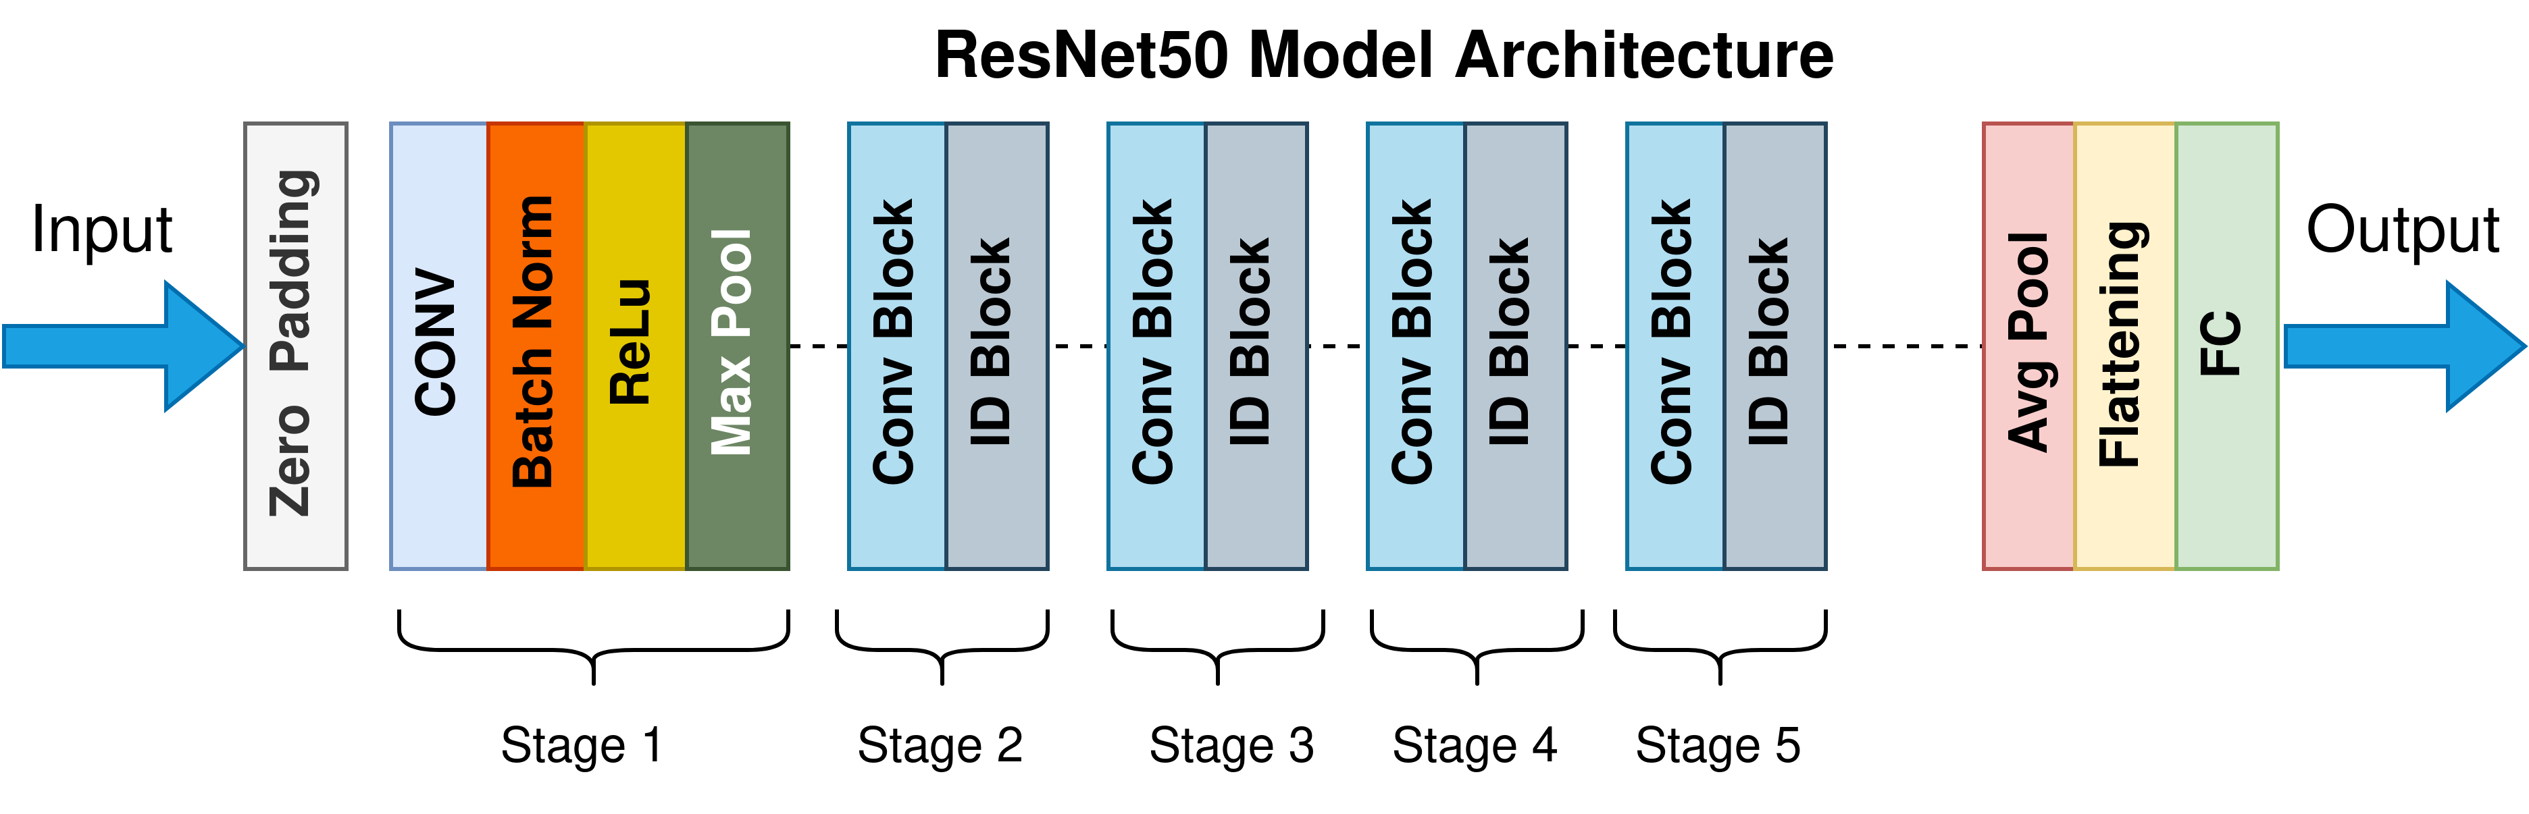
Modelling
BERT
(Text)
RESNET50
(Image)
CLIP
(Multimodal)

Slide 17
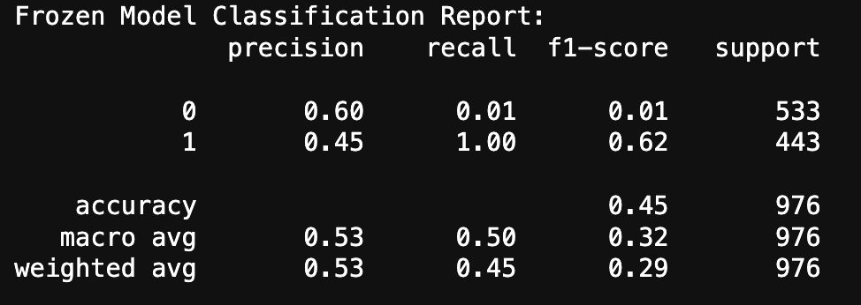
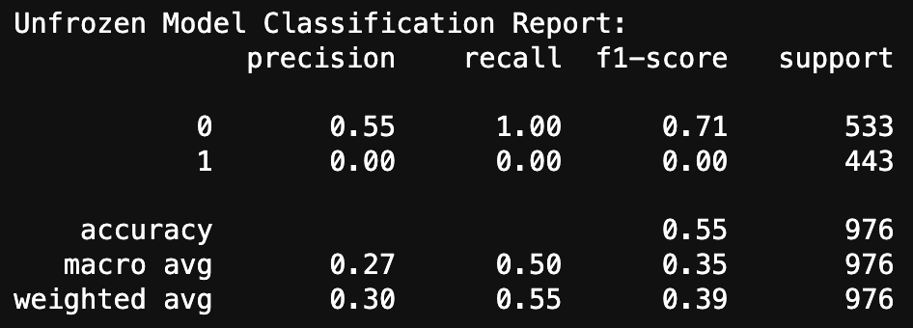
BERT Model
All predictions are heavily skewed towards one class
Trained for 3 – 5 epochs
Adam Optimizer

Slide 18
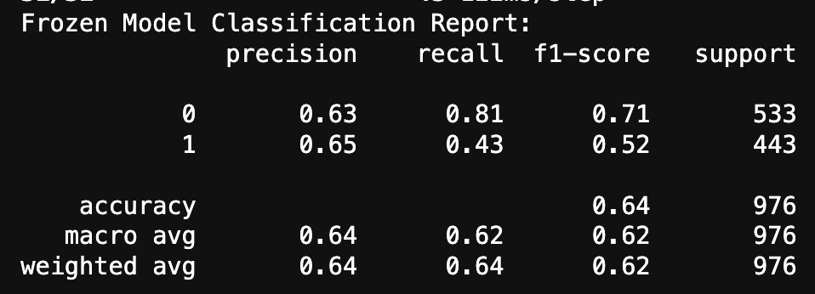
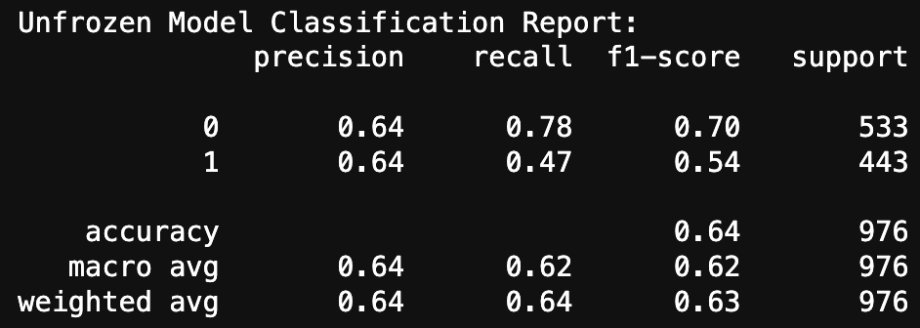
RESNET Model
Image is more important than text in classifying harmful memes
Trained on 10 – 20 epochs (early stopping)
Adam Optimizer

Slide 19
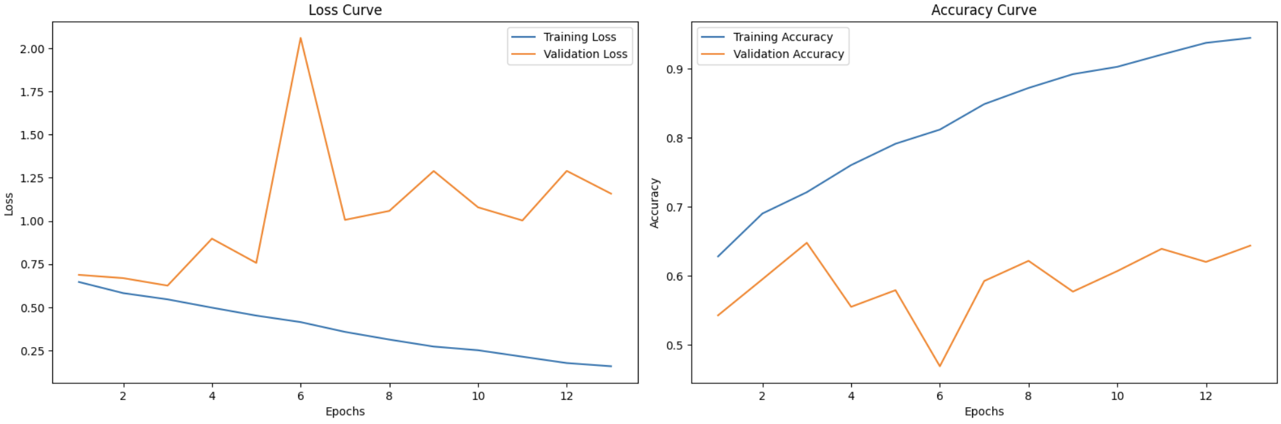
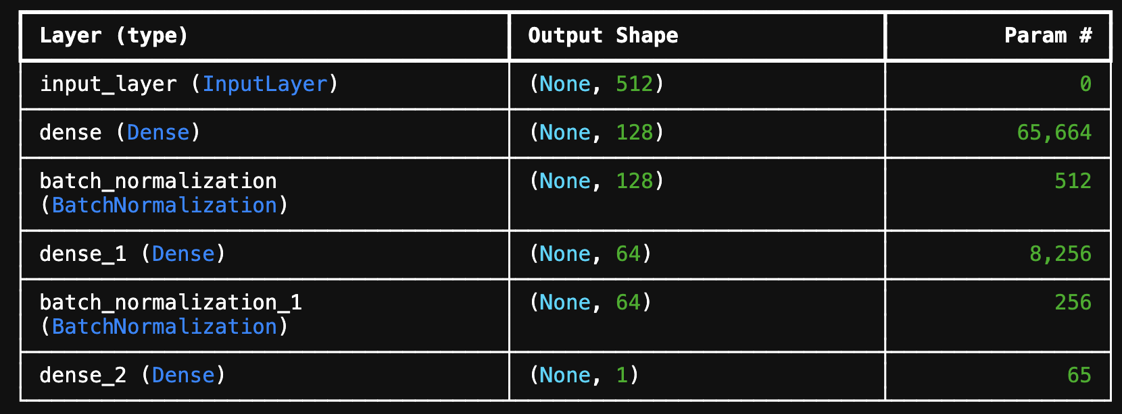
OpenAI CLIP Embeddings
Generate clip embeddings for both image and text.
Fused both embeddings using element-wise multiplication operation
Trained very simple neural network to predict label on these embeddings

Slide 20
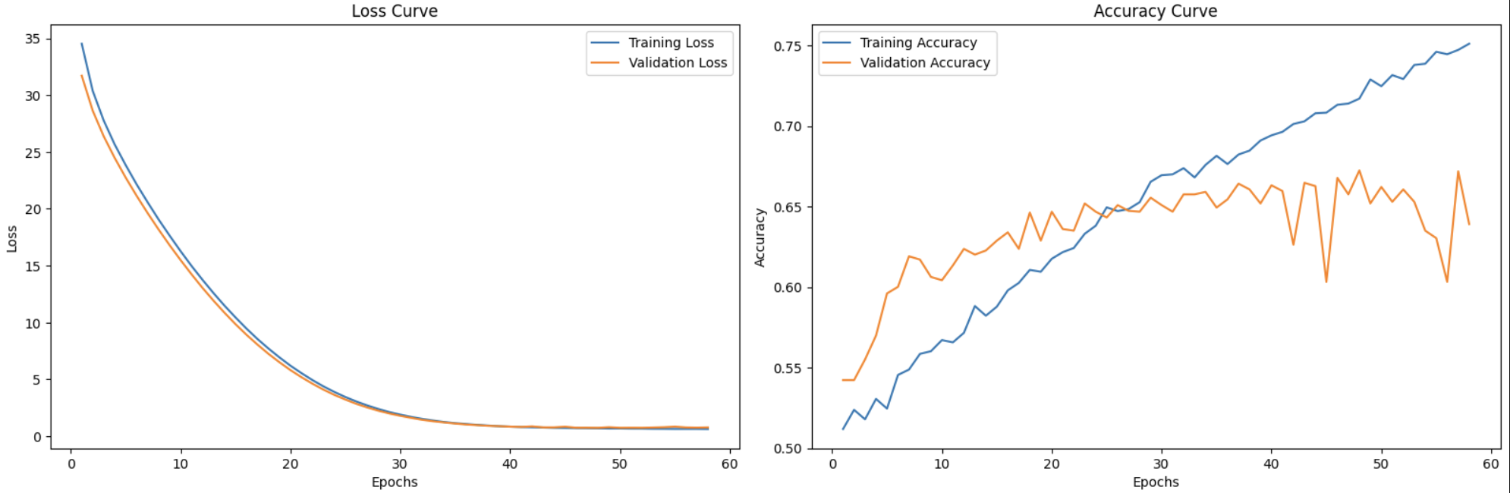
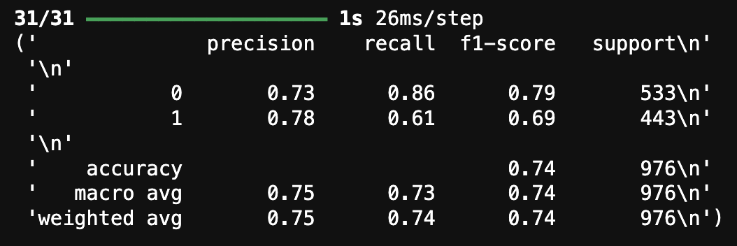
OpenAI CLIP Embeddings
Increasing the number of hidden layers to 4
Adding a high dropout rate of 0.6
L2 Regularization 0.01
Implementing skip/residual connections
Using AdamW optimizer with initial learning rate of 1e-4

Slide 21
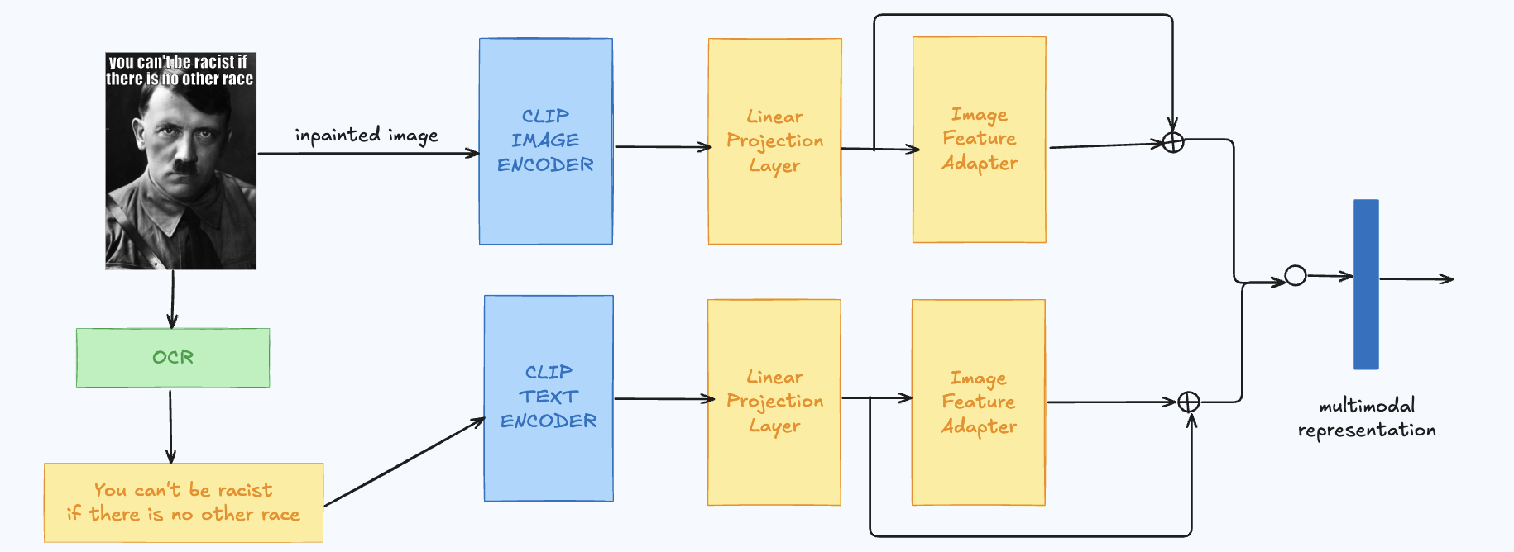
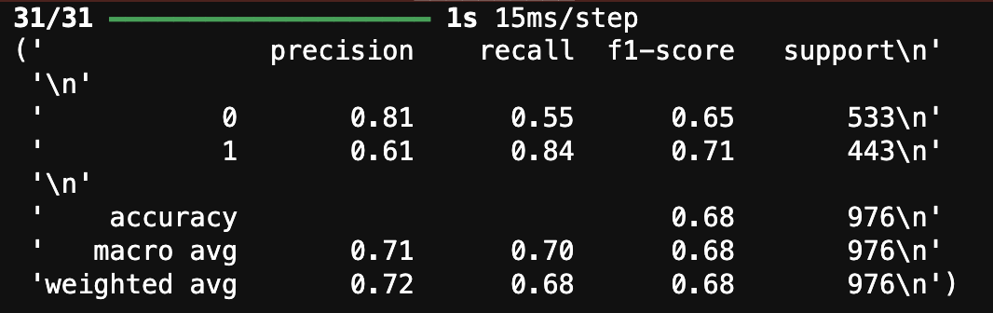
MemeCLIP Implementation
Linear Project: transform data from one dimensional space to another
Feature Adapter: help model to adapt to new task better

Slide 22
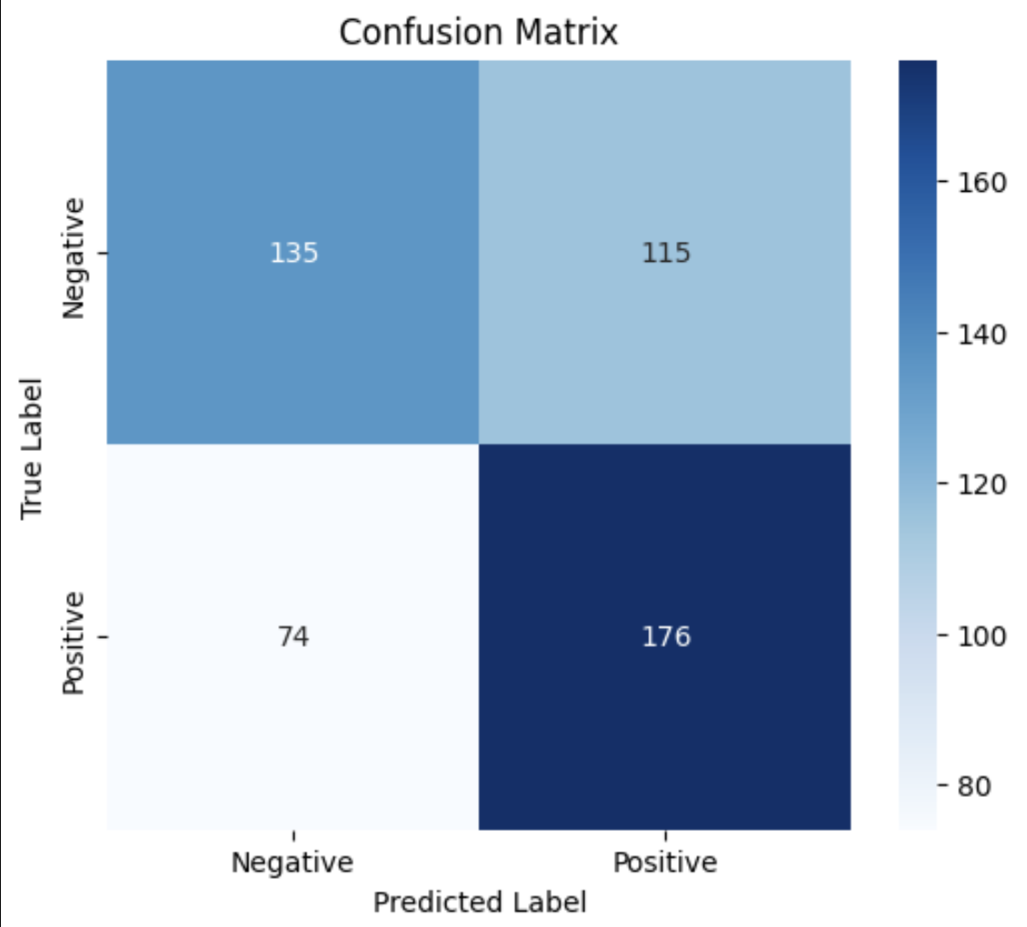
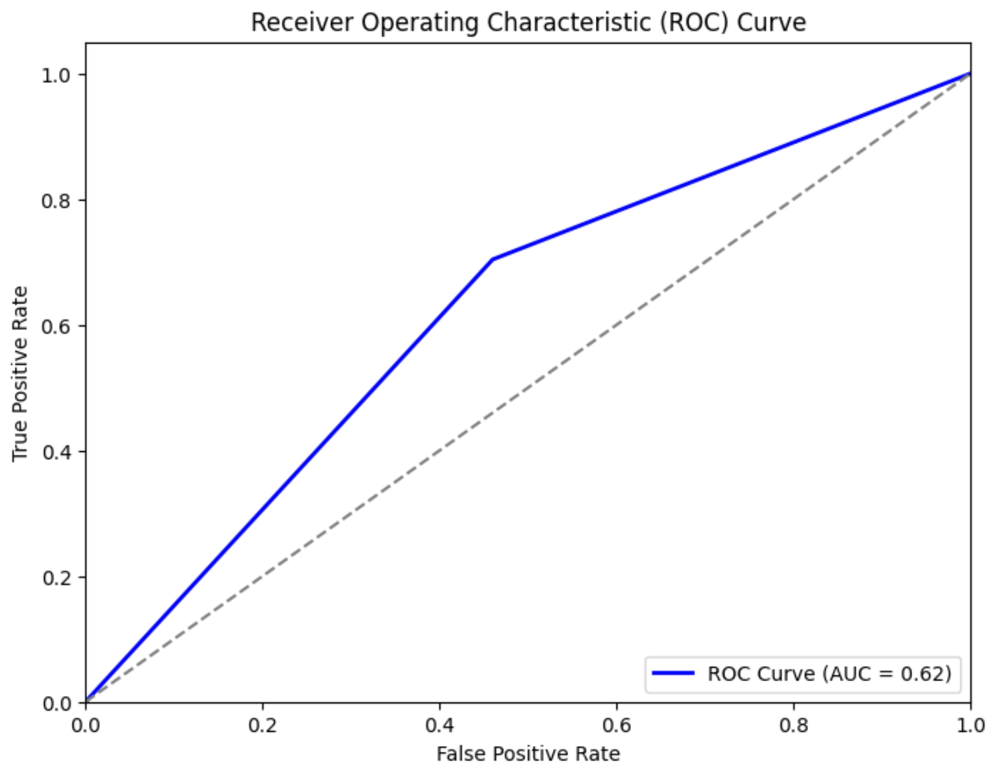
Metrics
High number of false positives (investigate)
62% discriminative ability

Slide 23
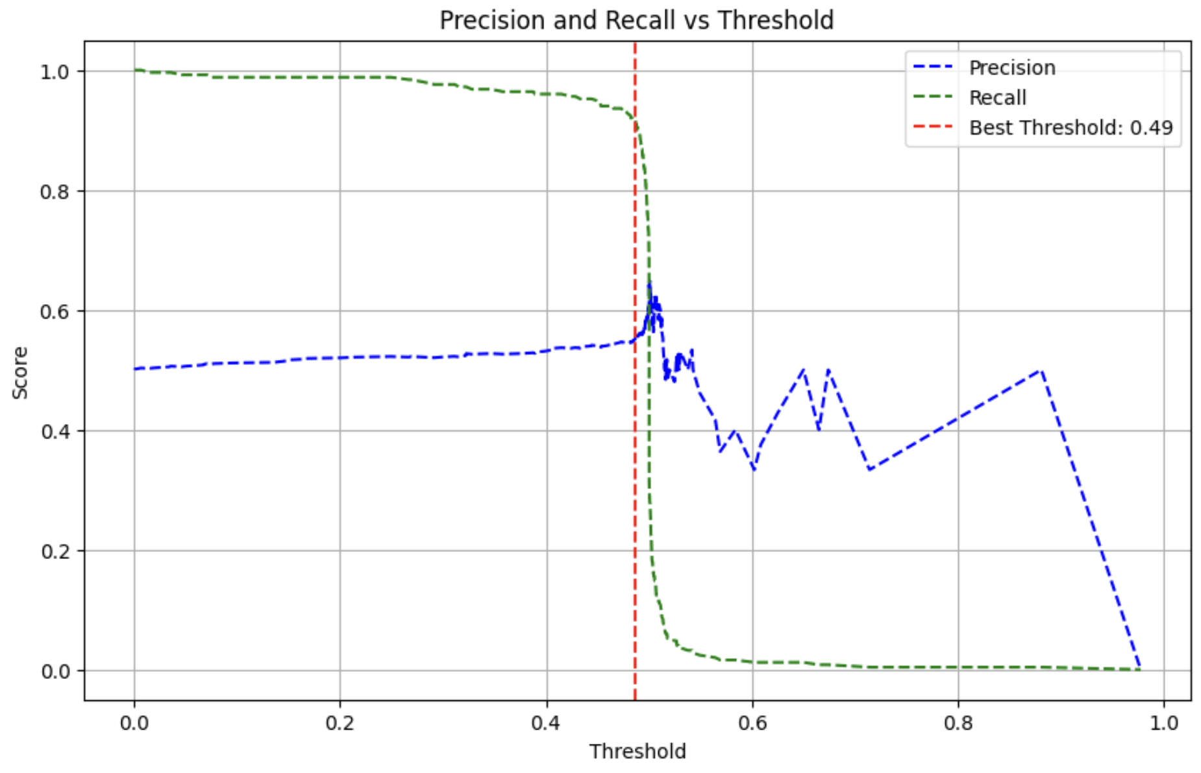
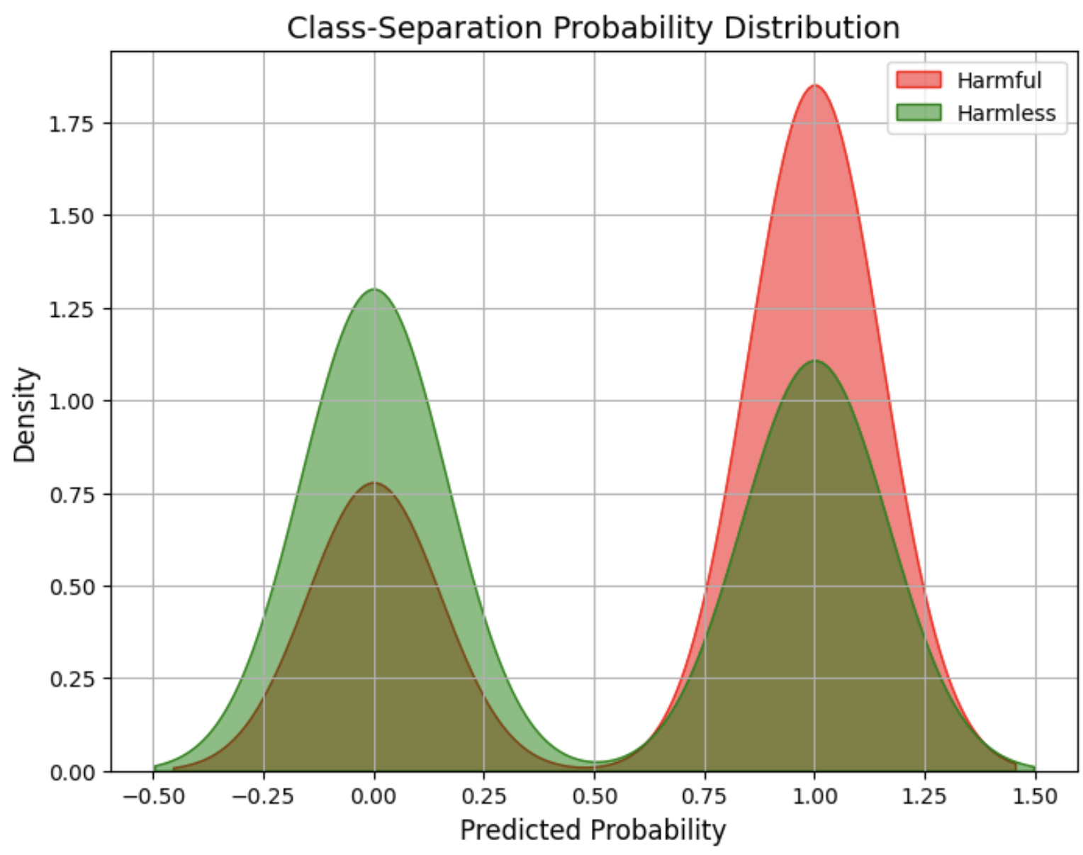
Metrics
Threshold of 0.5 is good
Decent separation, with some overlap

Slide 24
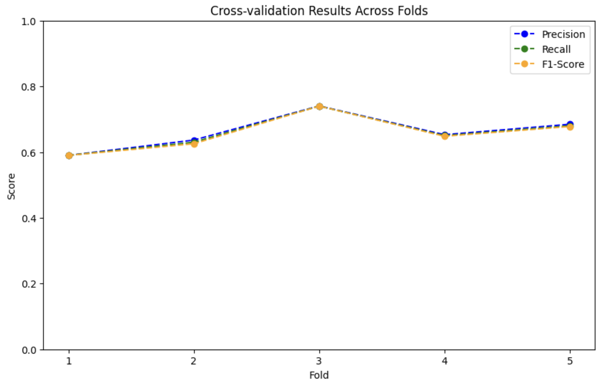
Metrics
Consistent model performance across all the fold during 5 fold -CV

Slide 25
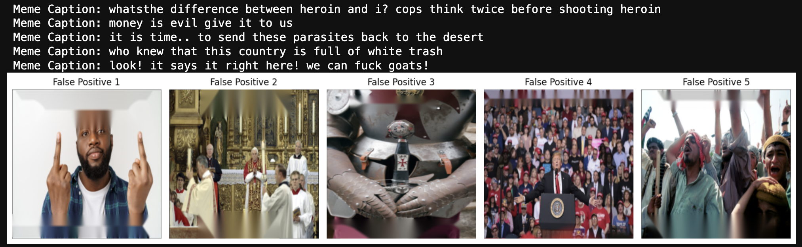
Metrics
Could be due to annotation errors from facebook harmful meme dataset
Addressed through model retraining loop

Slide 26
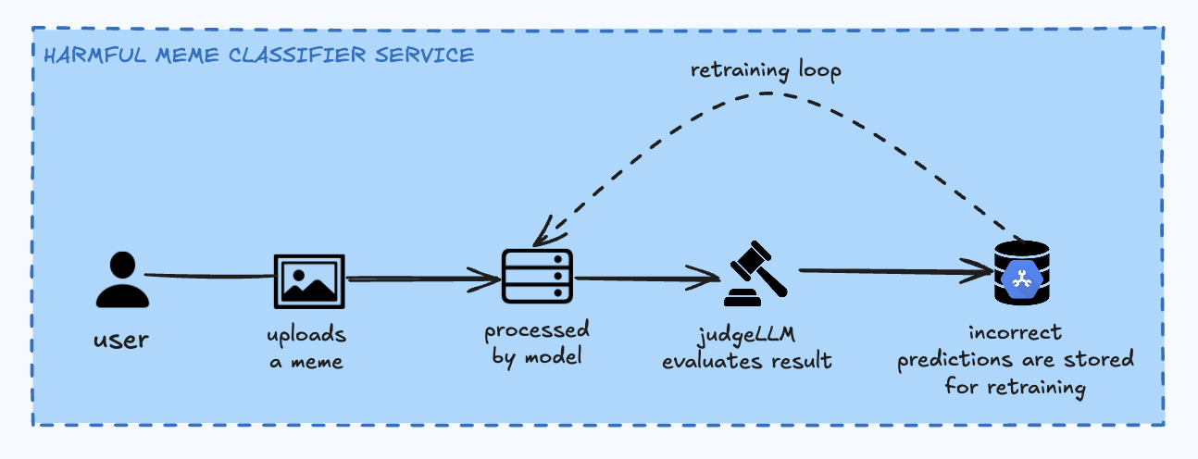
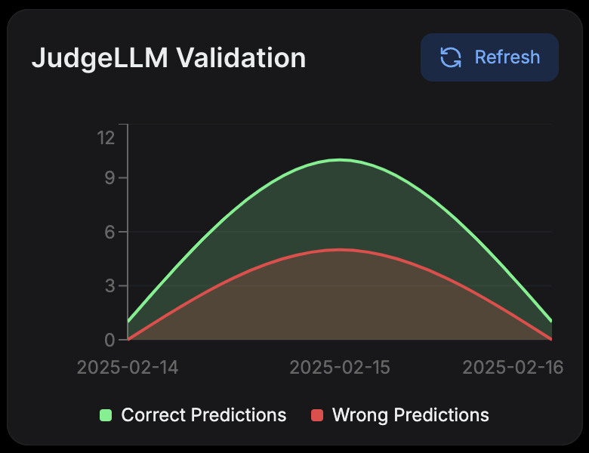
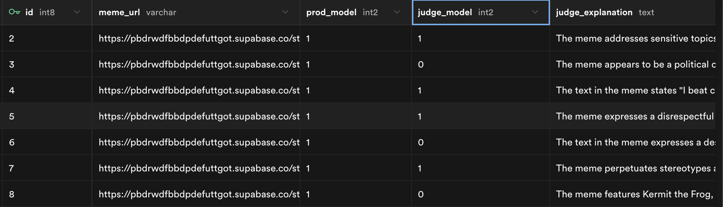
JudgeLLM Retraining Loop (add feat.)

Slide 27
Deep Fake Detection
Identifying deep fakes on social media platforms

Slide 28
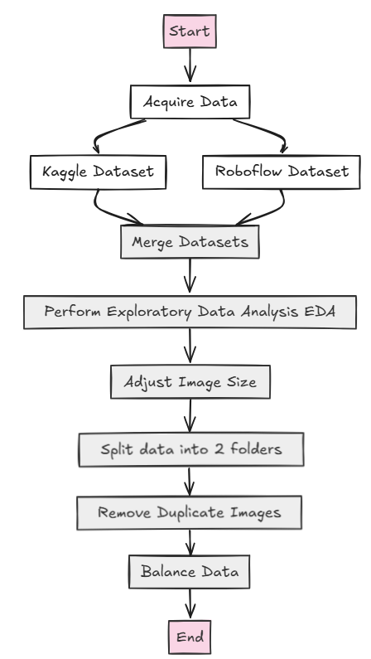
Datasets
Kaggle dataset
Subset of this dataset, which has over 470GB worth of videos of real and deep fake videos.
Over 95,000 images of faces extracted from the first frame of each video.
Roboflow dataset
Its images have filters applied, (i.e 1 image has 4 versions with different filters)
Helps the model to be more robust.
Contains close to 30,000 images
Undersampling was used to balance the data
More than 30,000 real images

Slide 29
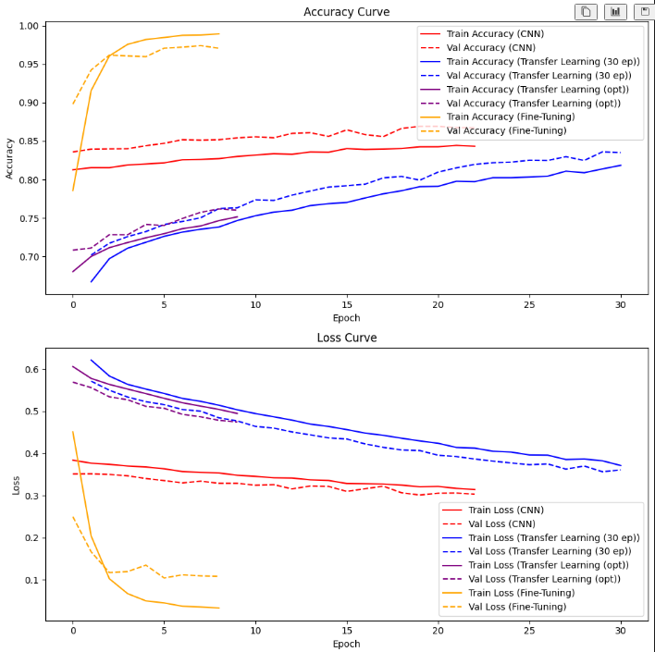
Modelling
Model Selection: Transfer Learning model trained for 30 epochs was chosen over CNN and Transfer Learning with optimization.
Model Size & Performance:
30-epoch Transfer Learning model: 80MB (smallest, best real-time performance).
Transfer Learning with optimization: 240MB (larger, more resource-intensive).
CNN from scratch: 450MB (largest, slowest for real-time detection).
Why the 30-epoch Transfer Learning model?
Balanced trade-off between size, efficiency, and speed.
Meets target accuracy of 80% while being deployment-friendly.
Training Strategy: Early stopping was used, resulting in some models training for fewer epochs.

Slide 30
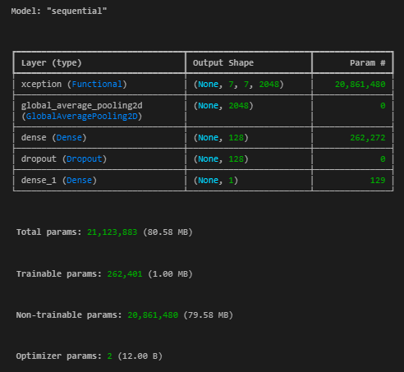

Tuning
Xception Model
Parameters:
Base Model: Xception (pre-trained on ImageNet)
include_top=False: Excludes fully connected layers
weights='imagenet': Uses pre-trained weights from ImageNet
input_shape=(224, 224, 3): Input size 224x224 with 3 RGB channels
Base Model Freezing:
base_model.trainable = False: Freezes weights of base model during training
Custom Layers:
GlobalAveragePooling2D(): Averages each feature map to reduce dimensions
Dense(128, activation='relu'): Fully connected layer with 128 units and ReLU activation
Dropout(0.5): Dropout layer with 50% dropout rate to prevent overfitting
Dense(1, activation='sigmoid'): Output layer for binary classification

Slide 31
Tuning
Compilation Parameters
Optimizer: adam (for faster convergence)
Loss Function: binary_crossentropy (for binary classification)
Metrics: accuracy (tracks training accuracy)
Callbacks
EarlyStopping:
monitor="val_loss": Monitors validation loss
patience=3: Stops training after 3 epochs of no improvement
restore_best_weights=True: Restores weights from the best epoch
CSVLogger: Logs training history to training_log_X_V2.csv
Others:
Epochs: 30 epochs
Batch Size: 64

Slide 32
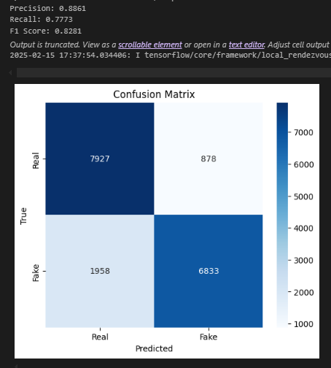

Performance
Model Evaluation
- Precision: 88.61%
Reliable when the model classifies something as "Real."
- Recall: 77.73%
Room for improvement to reduce missed "Real" instances.
- F1-Score: 0.8281
Solid balance between precision and recall.
- False Negatives: 1958
Key area for improvement to increase recall and boost F1-score.

Slide 33
Performance
Areas for Improvement
- Improve Model Robustness:
Fine-tune the model to minimize both false positives and false negatives.
Aim for a more balanced outcome.
- Increase Recall:
Focus on reducing false negatives.
Adjust decision threshold

Slide 34

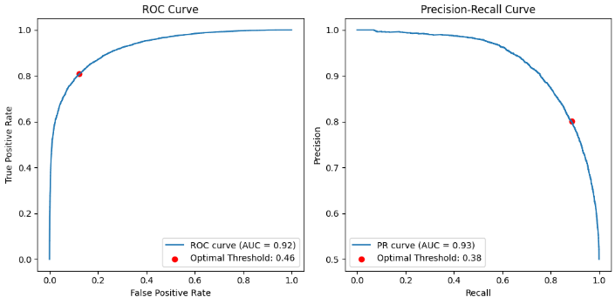
Performance
ROC Curve (Threshold = 0.46)
The optimal threshold here is chosen to balance True Positive Rate (TPR) and False Positive Rate (FPR).
Since ROC is good at assessing general classification performance, this threshold optimizes the distinction between positive and negative classes.

Slide 35
Performance
PR Curve (Threshold = 0.38)
The Precision-Recall Curve is more useful when dealing with imbalanced datasets.
The optimal threshold here is chosen to balance Precision and Recall, which is different from balancing TPR and FPR.
Since recall is high at lower thresholds, the PR curve often suggests a lower optimal threshold than ROC.

Slide 36

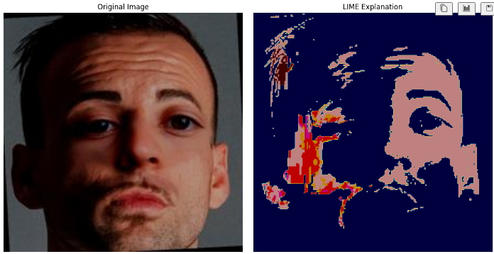
Testing
The image above is a deepfake.
Dark Red Areas: These areas highlight the regions that have the most negative influence towards the "fake" class. In simpler terms, these are the parts of the image that the model "sees" as the strongest indicators of the image being a deepfake.

Slide 37
Fake News Classifier
JUN MING add a one line description here

Slide 38


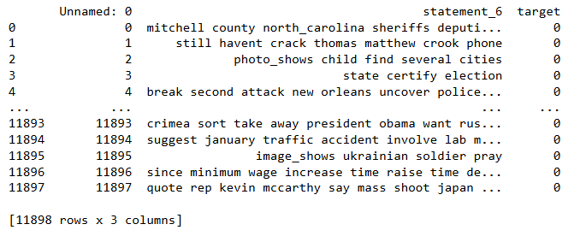
Datasets
Web Scraping:
Scraped 200 pages from PolitiFact using Python.
Collected ~5K records.
Includes 2023-2025
Hugging face Dataset:
Retrieved the LIAR2 dataset from Hugging Face using Pandas.
Includes ~23K records.
From 2000 to 2022
Final dataset:
~12K records
From 2019 to 2025, and after cleaning.
2 columns: statement and target column (0 for fake news 1 for truthful news)

Slide 39
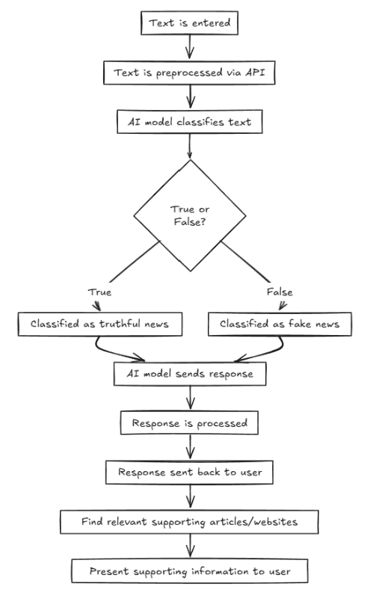
Pipeline
Text Input: User inputs text into the frontend.
Backend Processing: Input is sent to the backend, where it undergoes consistent preprocessing steps.
Model Classification: Preprocessed text is classified by the model.
Formatting: The classification result is formatted.
Article Retrieval and summary: Relevant articles on the topic are retrieved and concised.
Response: The user receives the classified result along with the relevant articles.

Slide 40
Findings
Comparison | Model | F1 Score (macro) | Best Choice
Best Classical Model | Random Forest | 0.729 | ✅ Random Forest
Anomaly Detection | One-Class Neural Network | 0.49 | ❌ Not Recommended
Best Embeddings | GloVe vs Word2Vec vs BERT | - | ✅ GloVe
RNN (LSTM) vs FNN | LSTM: 0.73, FNN: 0.74 | 0.73 vs 0.74 | ✅ FNN
Classification head | Distilled BERT | 0.67 | ❌ Not Recommended

Slide 41
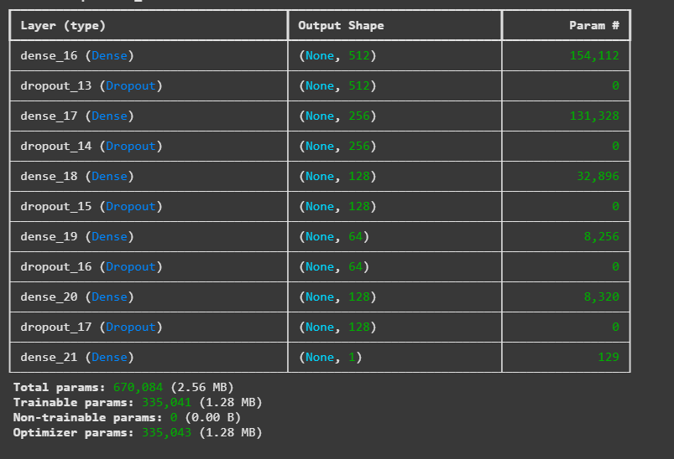
Tuning
Models Explored:
Architectures: RNN, CNN, FNN
Embeddings: BERT, Word2Vec, GloVe, TF-IDF
Preprocessing: With vs. Without Text Preprocessing
Optimizers: SGD vs. Adam
Hyperparameters: L1/L2 Regularization, Dropout, Layers, Neurons
Best Model Configuration:
Architecture: [512, 256, 128, 64, 128] (Hidden layer) (relu)
Optimizer: SGD (Learning Rate: 0.001, Momentum: 0.95)
Regularization: L2 (0.001), Dropout (50%)
Training: 50 Epochs, Batch Size: 32, Early Stopping (Patience: 10 Epochs)

Slide 42
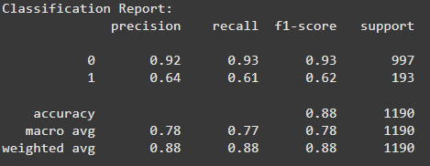
Performance
Class 0 (Fake News)
Precision: 92% (Predictions for class 0 are correct 92% of the time)
Recall: 93% (Captures 93% of actual fake news)
F1-score: 0.93 (Strong balance between precision and recall)
Class 1 (True News)
Precision: 64% (Predictions for class 1 are correct 64% of the time)
Recall: 61% (Captures only 61% of actual true news)
F1-score: 0.62 (Lower performance compared to class 0)
Overall Performance
Macro Avg F1-score: 0.78 (Balances both classes despite imbalance)

Slide 43
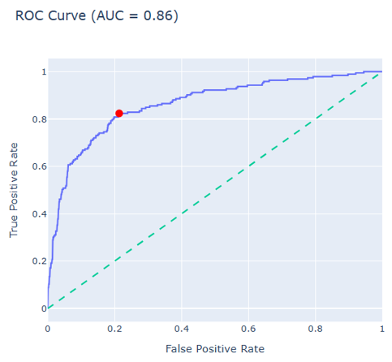
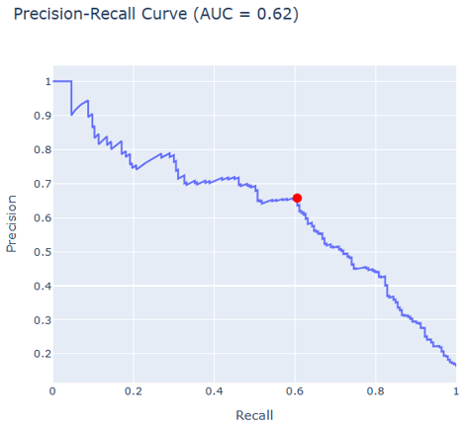
ROC and PRC

Slide 44
Mental Health Classifier
The mental health classifier aims to offer actionable insights and support resources to improve well-being.

Slide 45
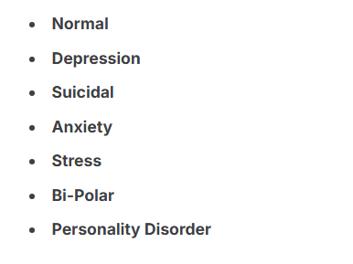
Dataset
Curated collection of mental health statuses, tagged from various statements, complied from multiple sources for sentiment analysis.
Features:
unique_id: A unique identifier for each entry
Statement: The textual data or post
Mental health status: The tagged mental health status of the statement.

Slide 46
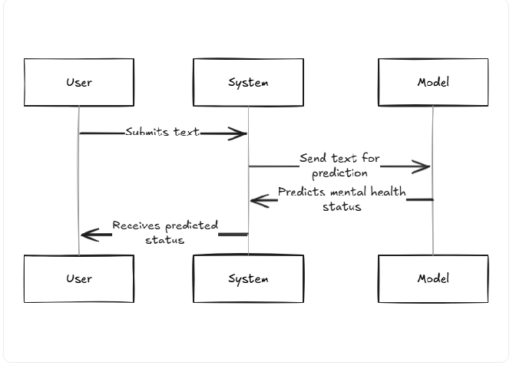
Pipeline
Mental Health Classifier Workflow
1. User Input – The user submits text
2. Backend Processing – The input text is preprocessed (API)
3. Classifier – The model analyzes the preprocessed text and classifies it into one of seven mental health statuses
4. Response Generation - The system prepares a response that includes:
The predicted mental health status.
The confidence level of the prediction.
Relevant articles, helplines, or support groups for further assistance.

Slide 47
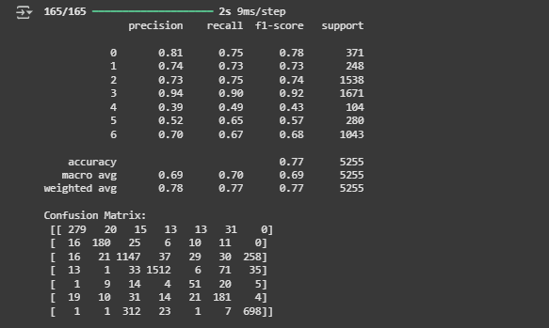
Performance (LSTM)
Model Performance Summary
Overall Accuracy: 77%
Weighted Averages:
Precision: 0.78
Recall: 0.77
F1-Score: 0.77
Class-Wise Performance:
Class 3: Outstanding Performance with Precision, Recall and F1-Score > 0.90.
Classes 0,1,2,6: Moderate Performance with F1-Scores between 0.68 and 0.78.
Confusion Matrix:
Class 3: 1512 correct predictions, minimal misclassifications.
Class 0: 279 correct predictions, some misclassifications to other classes.

Slide 48
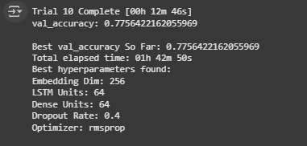
Tuning (LSTM)
Best Validation Accuracy Achieved: 77.56%
Optimal Hyperparameters Found:
Embedding Dimension: 256
LSIM Units: 64
Dense Units: 64
Dropout Rate: 0.4
Optimizer: RMSprop
Improve Model’s Performance
Improve Model’s Generalisation
> Leads to better predictions

Slide 49

Deployment

Slide 50



Demo

Slide 51
Future Enhancements
More Models | Voice deepfake, file malware analyser, detection of AI generated content, and more.
Data Driven Analysis | Dashboards to analyse misinformation themes and provide data driven decisions and strategies to combat them.
Easy Integration | Cross compatibility and integration across various social media platforms and devices.

